Slide 1

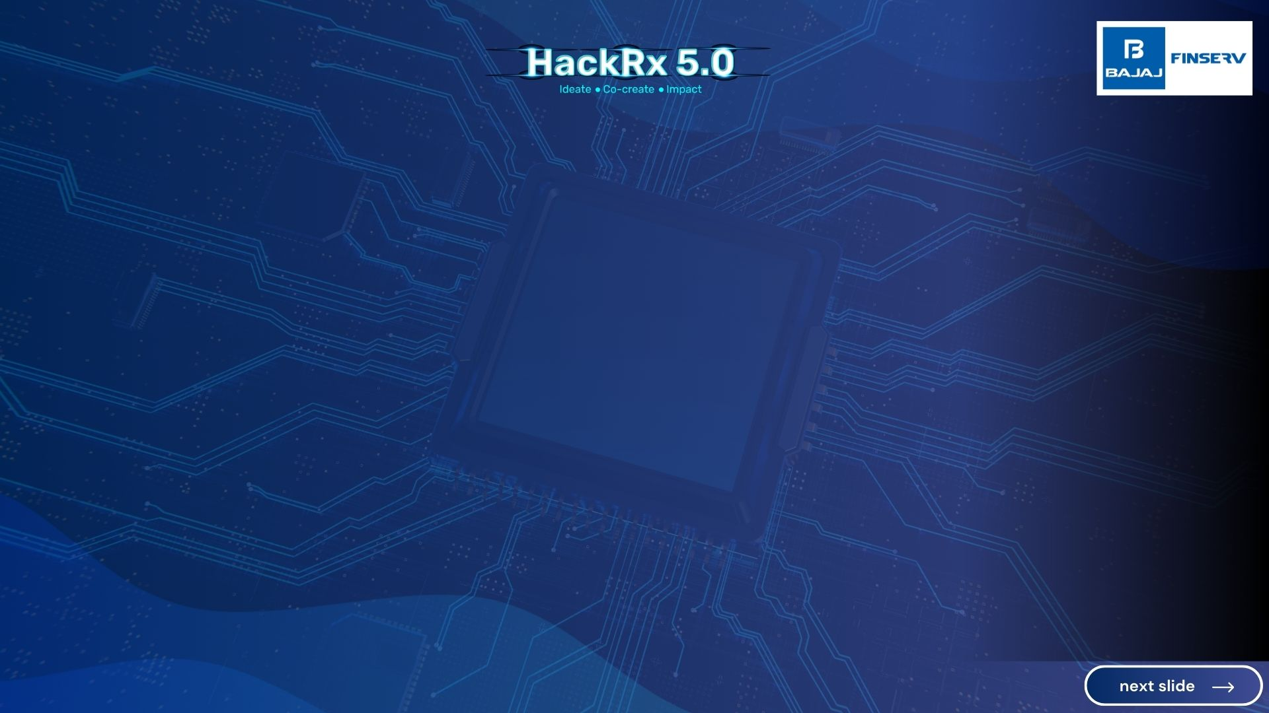
DOCKER
SRI KARTHIK | 2025 | VIT CHENNAI
SHASHANK PANDEY | 2025 | VIT CHENNAI
PIYALI SAHA | 2025 | VIT CHENNAI
ATUL PATEL | 2025 | VIT CHENNAI

Slide 2
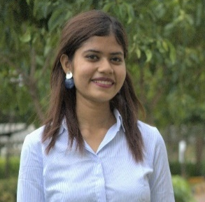


About ourselves
Hi, I’m Piyali Saha and you can call me Innovator and I have a keen interest in data science and have developed numerous models and designed algorithms . Additionally, I have contributed to data preparation efforts. My passion for problem-solving has driven me to participate in various hackathons, including SIH, American Express, House of Developers, and Strykathon, FlipkartGrid . Notably, I won the SIH competition for the Bajaj Finserv problem statement and secured the runner-up position in the House of Developers hackathon. Throughout my hackathon experiences, I have focused on understanding the underlying problems, viewing them as opportunities to create innovative and sustainable solutions.
Hi, I’m Atul Patel, and I consider myself a passionate advocate for data science and machine learning. I've actively participated in numerous hackathons, including the Smart India Hackathon, where I with my team emerged as a winner, and secured the runner-up position in the House of Developers hackathon. I've also been involved in competitions like Kryptothon, Healthathon, and Strykerthon, Flipkart Grid , Amazon Ml Challenge. My contributions have primarily centered around data science and machine learning, where I've played a key role in developing models, data pipelining and designing solutions. These experiences have deepened my passion for using data to solve real-world problems efficiently
Hi, I’m A Sri Karthik, and I specialize in solving complex problems. I’ve participated in several hackathons, including SIH, IBM Z Day, Amazon ML Challenge, where I reached the Grand Finals at the Stryker Hackathon and was the runner-up at the House of Developers Hackathon. My experiences have allowed me to hone my skills in tackling challenges and finding unconventional yet effective solutions that are both innovative and enduring. With a deep interest in AI, I constantly strive to push the boundaries of what's possible.

Slide 3
PS4: Context Aware Chatbot
OVERVIEW AND PROCESS FLOW
Objective
To develop a chatbot to generate accurate summaries and key points in response to user queries .
To implement functionality to extract and deliver relevant information from uploaded documents, PDFs, or presentations.
To build a domain-specific Large Language Model (LLM) specific to Bajaj Finserv's knowledge base for precise information retrieval.
To create a seamless user experience for executing actions such as booking, canceling, or modifying appointments.

Slide 4
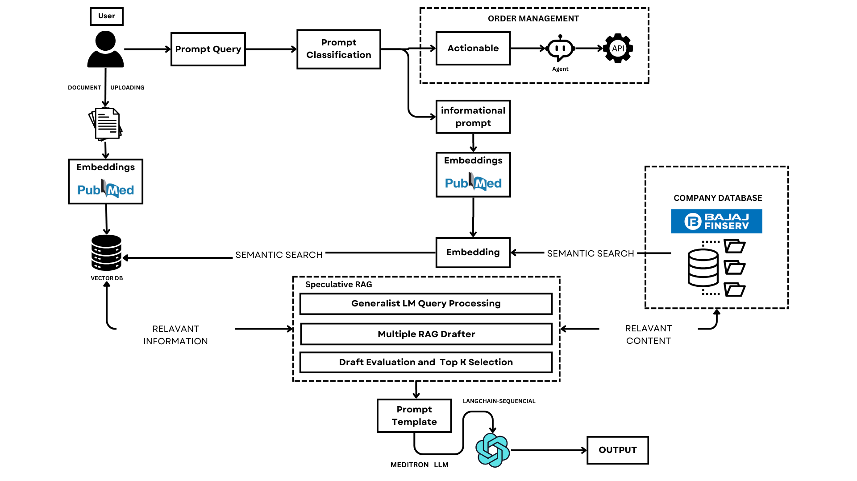

Architecture Diagram

Slide 5









Tech Stack
Cloud Service Providers:-
Database:- Vector database(Qdrant)
Backend:- python, Docker
Frontend:-Streamlit interface
Other relevant details (if any)

Slide 6
Detailed description of the solution
We are building a context-aware chatbot with two main functionalities:
Actionable Task Execution: Using Langchain’s Agent integrated with Zapier’s Natural Language Actions (NLA) API, our chatbot can perform tasks such as booking, canceling, or modifying appointments. The NLA API offers flexibility in incorporating external services.
Information Retrieval: For retrieving information, whether from uploaded documents or user queries, we implement a Speculative Retrieval-Augmented Generation (RAG) approach. This enhances efficiency by offloading tasks to specialized models, improving accuracy, and speeding up response times through parallel processing. We are using the Qdrant vector database to store features and a embedding model called PUBMEDBERT model, ensuring precise retrieval specific to medical domain. Additionally, the chatbot employs Custom Sequence Method to maintain context and a Sequential Chain to preserve the order of interactions.

Slide 7
Speculative Retrieval for Instant Responses and Sclability :
- Our chatbot utilizes Speculative Retrieval-Augmented Generation (RAG), enabling it to process and deliver responses in real-time.
- This approach significantly reduces response times, providing users with near-instant answers while maintaining high accuracy.
-Using Chroma DB for vector search and Zapier NLP API for conversational AI ensures a scalable, industrial-grade solution for deploying enterprise-level chatbots.
2. Contextual Awareness and Memory Management:
-The chatbot preserves conversation context seamlessly, allowing for coherent and relevant follow-up interactions.
-With Custom Sequence Method and Sequential Chain, it ensures that the flow of information remains consistent and l logical, even in extended conversations.
3. Comprehensive and Secure Knowledge Integration:
-Our solution integrates a robust knowledge base, capable of retrieving information from various formats like PDFs, PPTs, and external databases.
-It strictly sources information from the designated knowledge base, ensuring responses are accurate, reliable, and aligned with organizational guidelines.
4. Actionable Intelligence with Extensive API Integration:
-Beyond information retrieval, the chatbot can execute tasks such as booking appointments or managing orders through integration with Zapier’s NLA API.
-This enables users to perform actions efficiently without leaving the conversation, enhancing overall productivity and user experience.
.
So, how is our solution different?

Slide 8
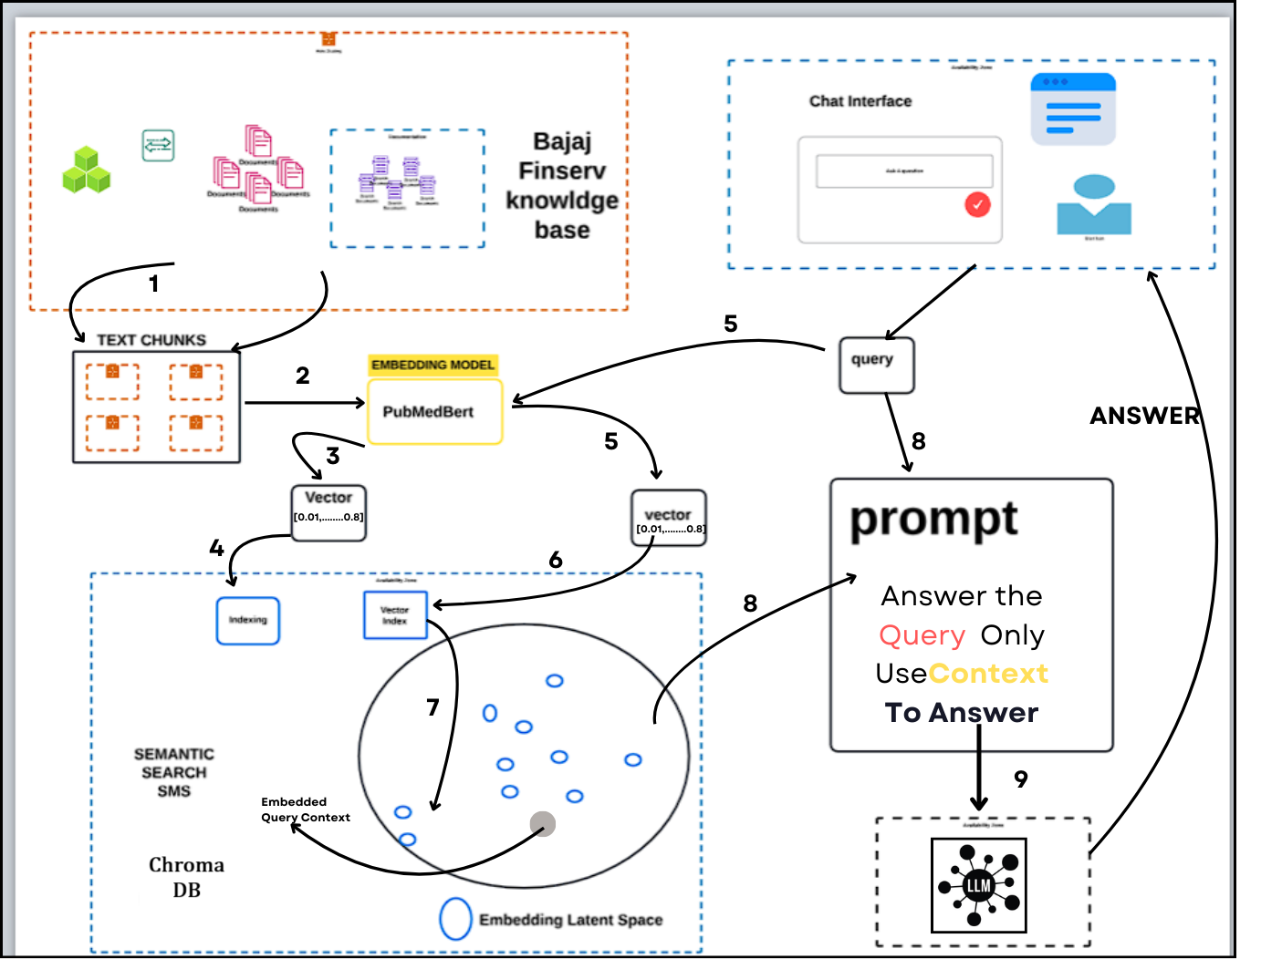

Data Flow Diagram

Slide 9
Out Put Screen Shot+Api enpoint as per gform and fill there also in g form

Slide 10
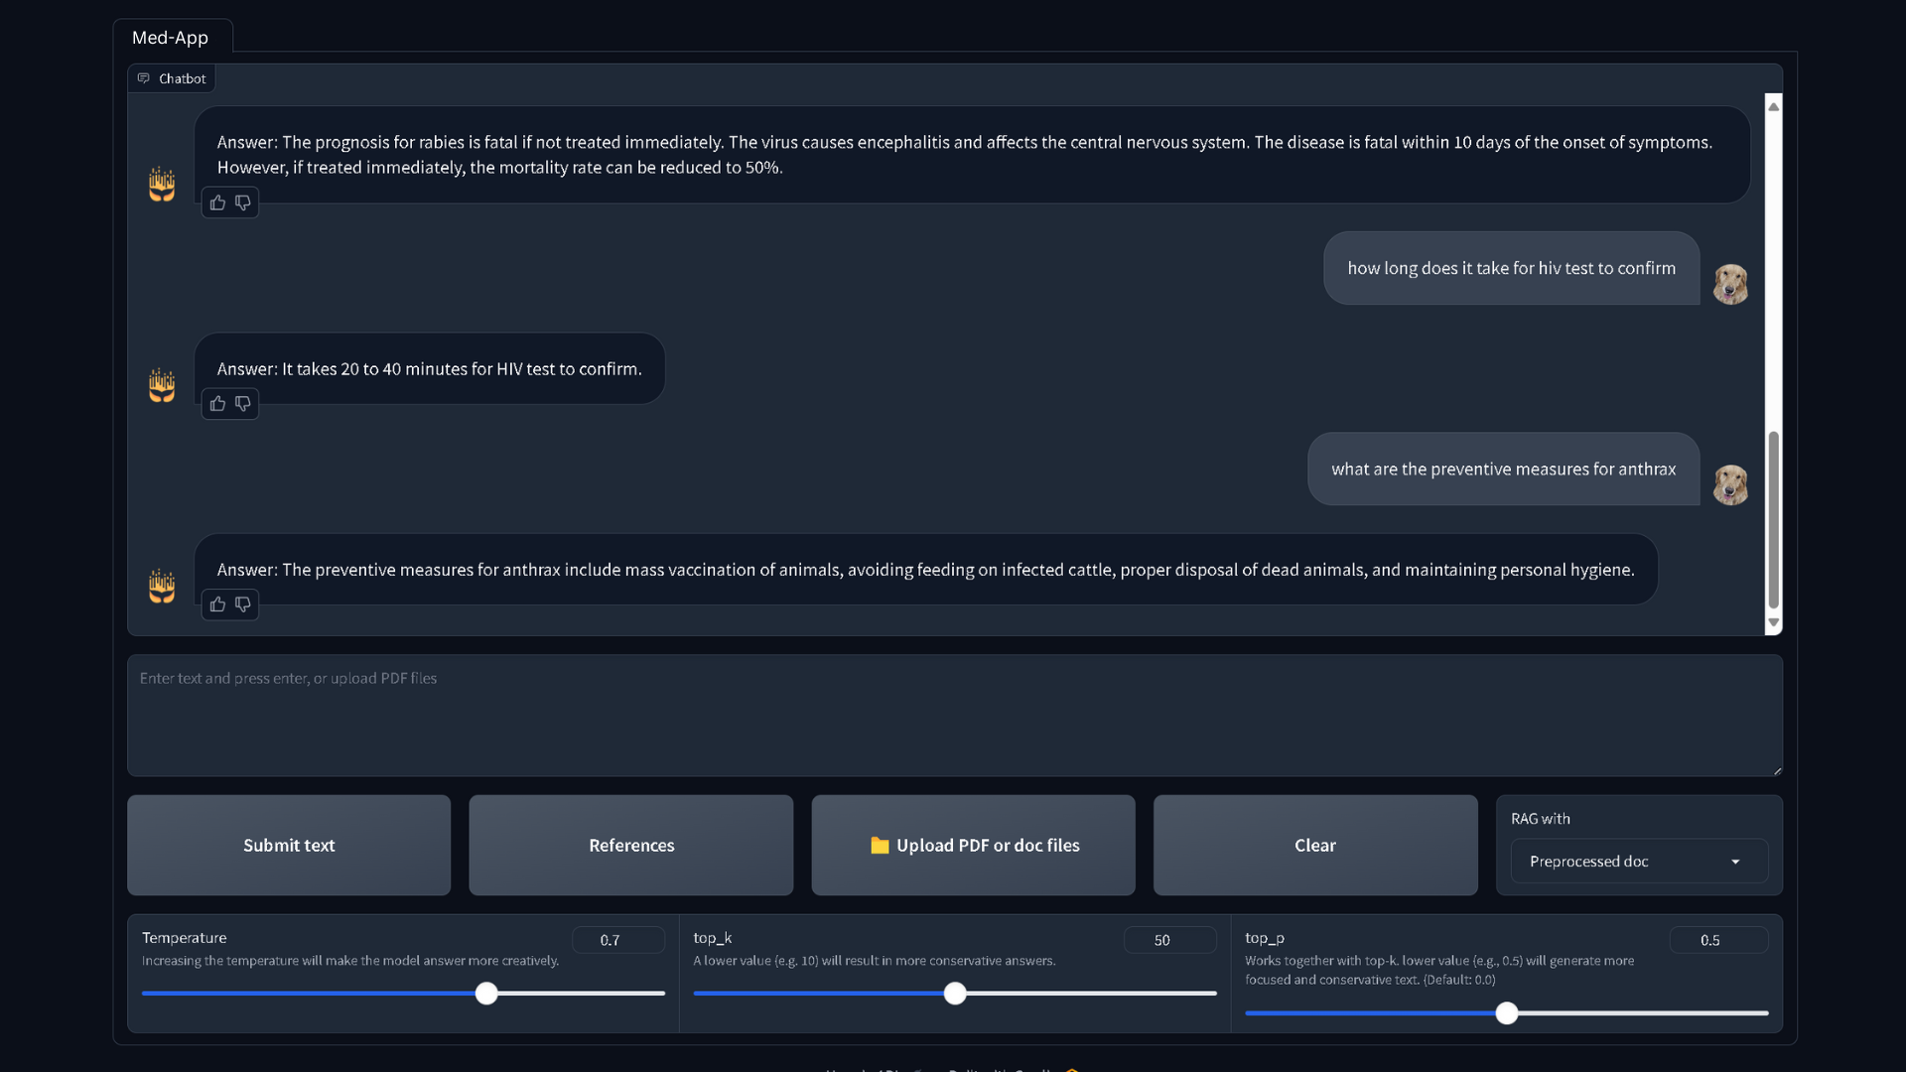
Out Put Screen Shot

Slide 11
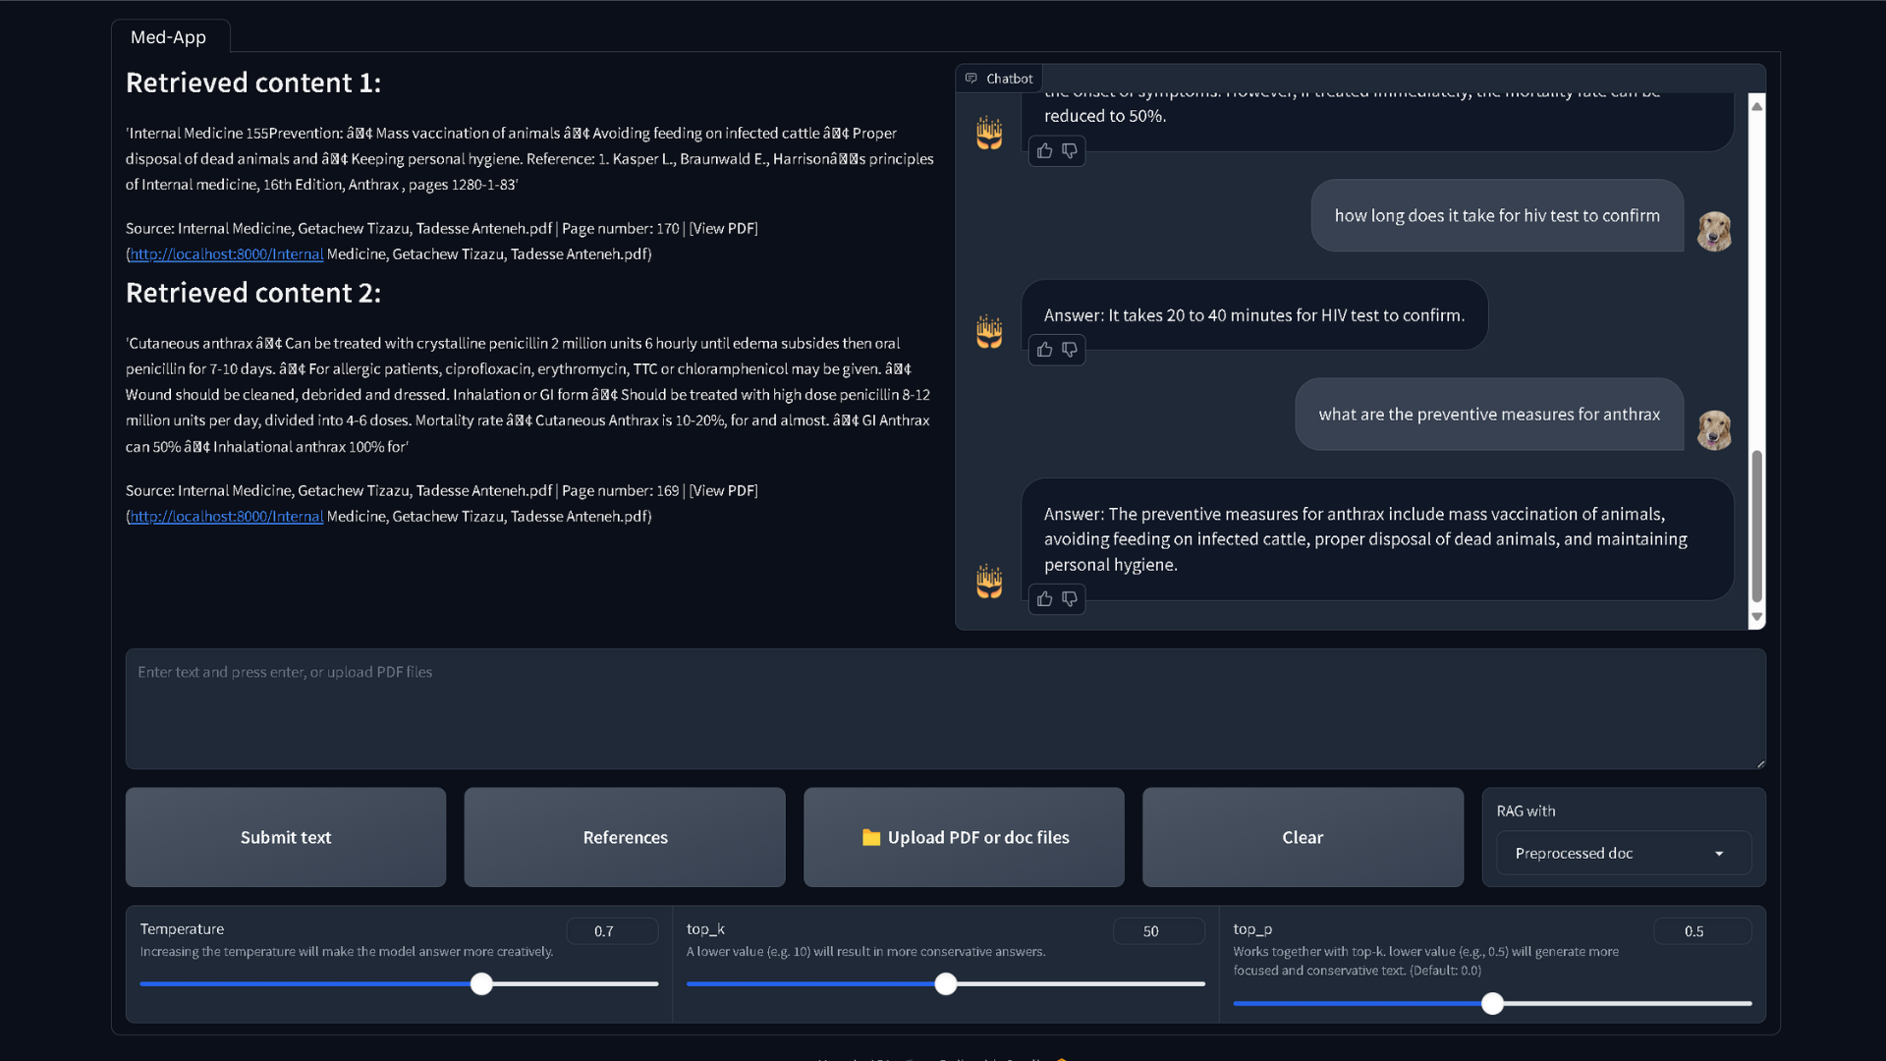
Out Put Screen Shot

Slide 12
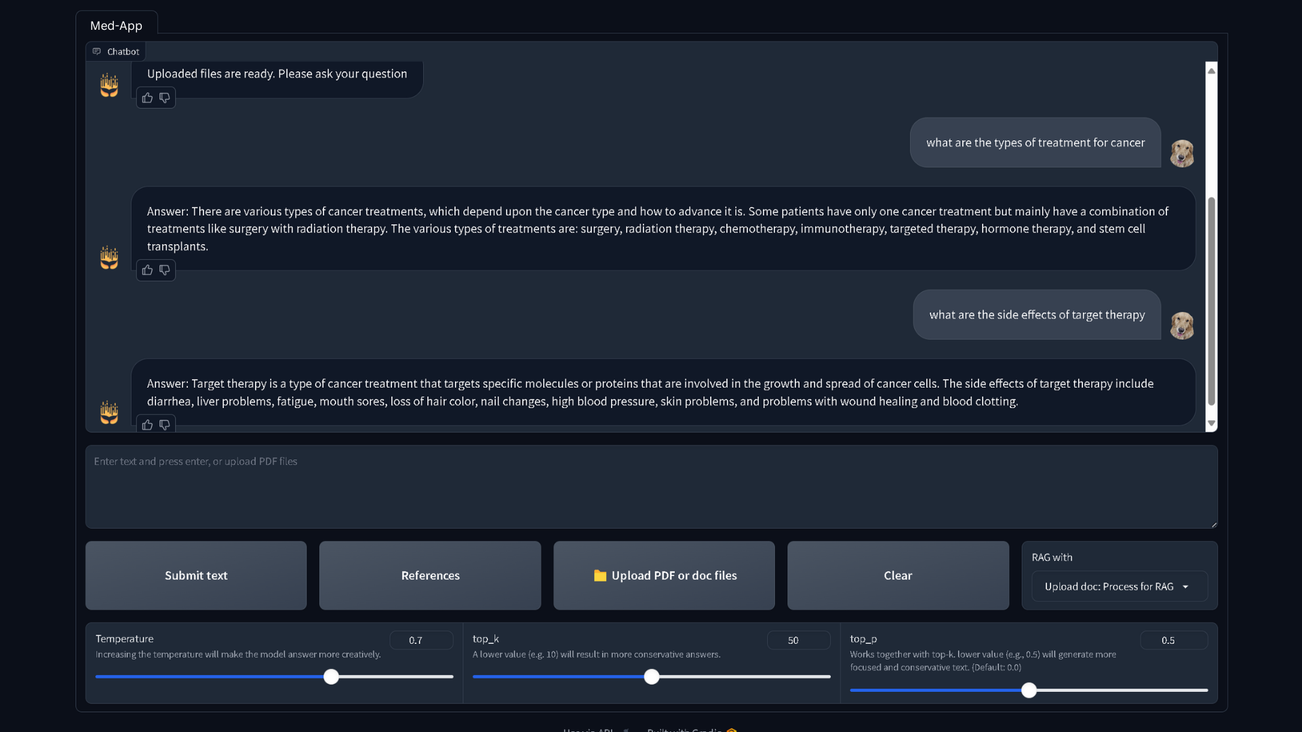
Out Put Screen Shot

Slide 13
Future possible enhancements
Proactive Suggestions: Implement features for offering proactive recommendations and automating routine tasks based on user behavior.
Voice Interaction: Introduce speech-to-text and text-to-speech capabilities to enable voice-based interactions.
Personalized User Experience: Use machine learning to tailor responses and actions based on user history and preferences.
Advanced Security Features: Integrate enhanced security measures such as user authentication, encryption, and role-based access control to protect sensitive information and transactions.

Slide 14
Risks/Challenges/Dependencies
API Reliability: Dependence on external APIs for actions (e.g., payments, order management) risks service interruptions or changes affecting functionality.
Security Concerns: Safeguarding sensitive user data and secure transactions is crucial to prevent data breaches and fraud.
Real-Time Data Updates: Implementing mechanisms for continuous updates to the knowledge base ensures the chatbot always delivers current and relevant information

Slide 15
Acceptance Criteria Coverage
The chatbot solution covers ALL ASPECTS of the problem statement across the following key areas:
Knowledge Base Integration:
- Fully integrated with multiple document formats (PDFs, PPTs, docs).
- Uses RAG Module and PUBMEDBERT for accurate information retrieval.
- Allows for real-time updates to the knowledge base, ensuring the system provides the latest information.
2. Action Execution:
- The chatbot supports a range of actionable tasks like order creation, cancellation, payment collection, and invoice
viewing via Langchain’s Agent and Zapier NLA API.
- Successfully returns human-readable results from these actions back to the user.
- Context Preservation:
- The system uses Custom Sequence Method to maintain context across multiple interactions and
Sequential Chain to manage follow-up queries.
- Ensures coherent, context-aware responses during ongoing conversations.
Thus, all core requirements related to knowledge integration, task execution, and conversation context are thoroughly addressed.

Slide 16
Additional information:

Slide 17
PS4: Context Aware Chatbot
Expected Submission
Upload the entire codebase to a private GitHub repository.
Ensure that all files are placed within a single repository.
Add the GitHub user hackrx-bot as a collaborator to the private repository.
Submit the form with the required details, including the endpoint you created: Form Link
This slide should not be included in the final pitch deck submission, as it is intended for informational purposes only.

